Slide 1
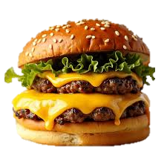
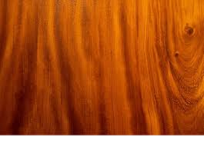

Slide 2
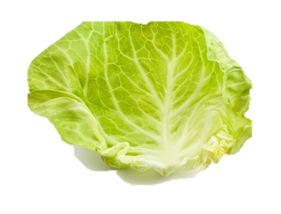
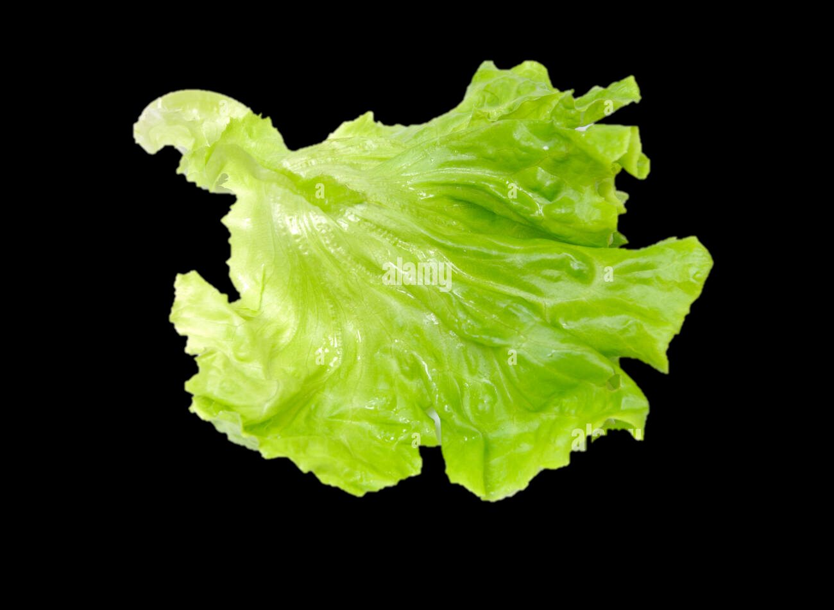
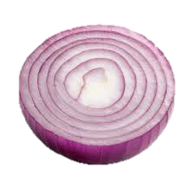
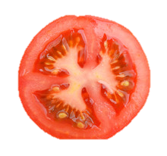
FRESH
BURGER

Slide 3

Feeling
HUNGRY?

Slide 4
Do visit
THE BURGER TOWN!

Slide 5

YUMMM BURGURSS.
Contact :- 98356 62804

